Slide 1
IICT PROJECT
TECHNTECH
Kaif Qureshi | 02-235222-013
Zonish Ahmed | 02-235222-022
Bilal Masroor | 02-235222-034
BSIT (1A)

Slide 2

Introduction
What is Techntech?
It is an E-commerce front end only website for buying and selling of laptops. It is built using HTML and CSS which are the core languages for building a static website. HTML is used for creating a structure of a website from top to bottom. CSS is used for styling our webpages and to make it look dynamic and user friendly at the same time.

Slide 3
OBJECTIVES
To provide customers with an easy-to-use and visually appealing interface for browsing and researching laptops.
To offer a wide range of laptops from different brands and manufacturers, with detailed information on each product's specifications and features.
To enable customers to easily compare prices and features of different laptops to make informed purchasing decisions.
To use the website as a marketing channel to promote new products, sales, and discounts.
To increase brand awareness and customer loyalty.
To increase online sales revenue and market share.

Slide 4
PROJECT PURPOSE:
The purpose of this project is to provide customers with an easy and convenient way to browse, research, and purchase laptops online. The website will aim to provide a seamless and user-friendly interface that allows customers to quickly find the laptops that meet their needs and preferences, such as brand, model, and price range. The website is also designed to provide detailed information on the laptops' specifications and features, to help customers make informed purchasing decisions and it also has a contact form for customers to get support and assistance in case of any issues.

Slide 5
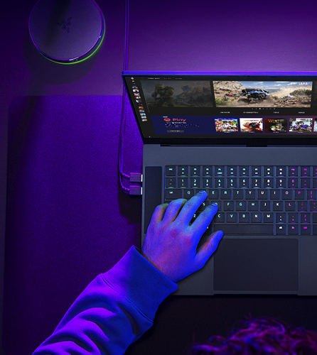
Project Overview
This website is divided into four pages:
Home Page
About Page
Contact Page
Product Page

Slide 6
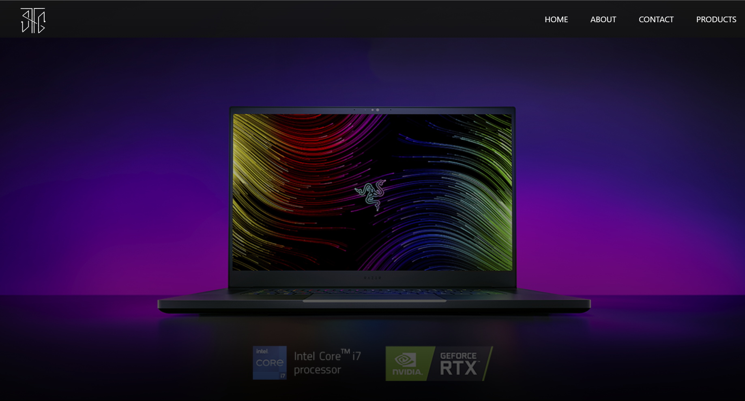
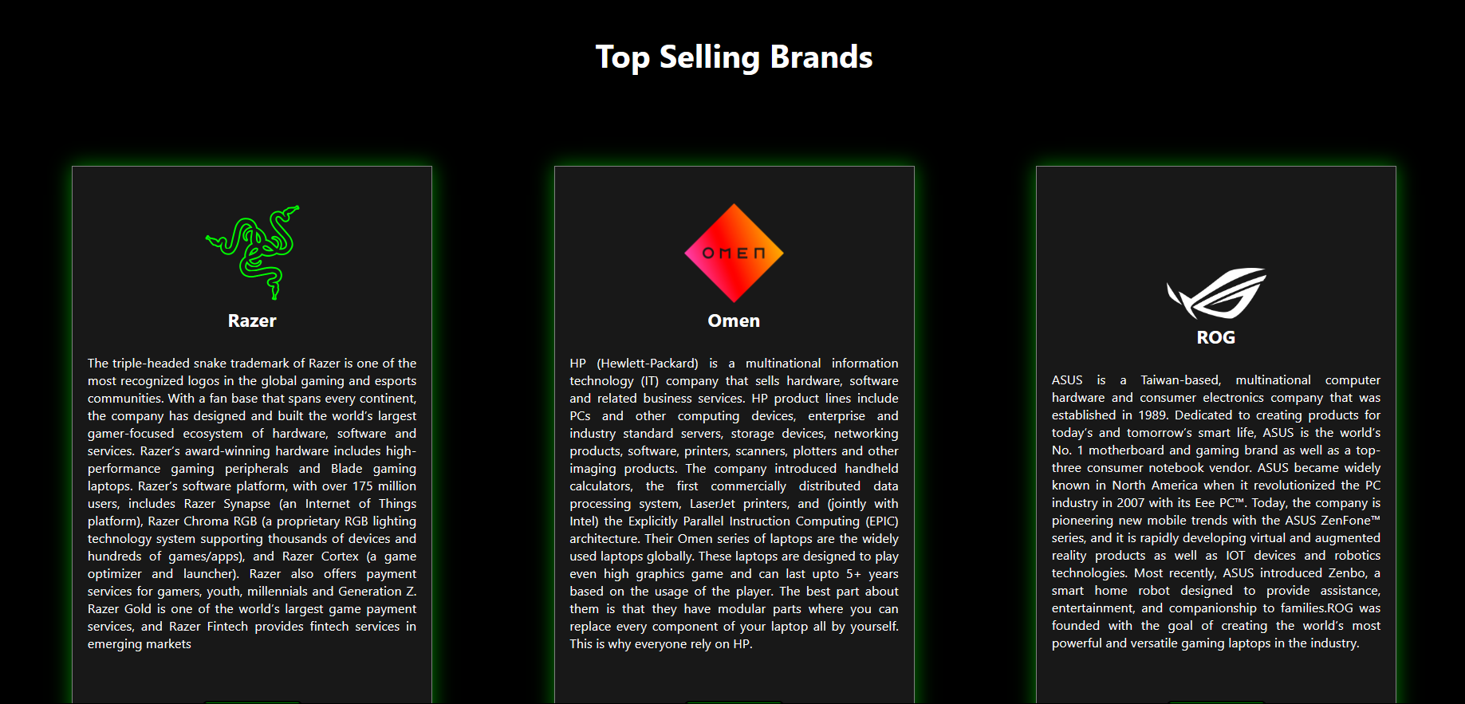
HOME PAGE
This homepage is divided into five sections:
Navigation Menu: It includes four links such as home, about, contact, products.
Background Banner: It is the picture used in the background.
Most Popular Brands: This section includes details about our most popular brands.
Most Watched Reviews: This includes our most watched reviews.
Footer: This includes sitemap and brief intro of our website.
Navigation Menu and footer section will remain constant on every page.

Slide 7
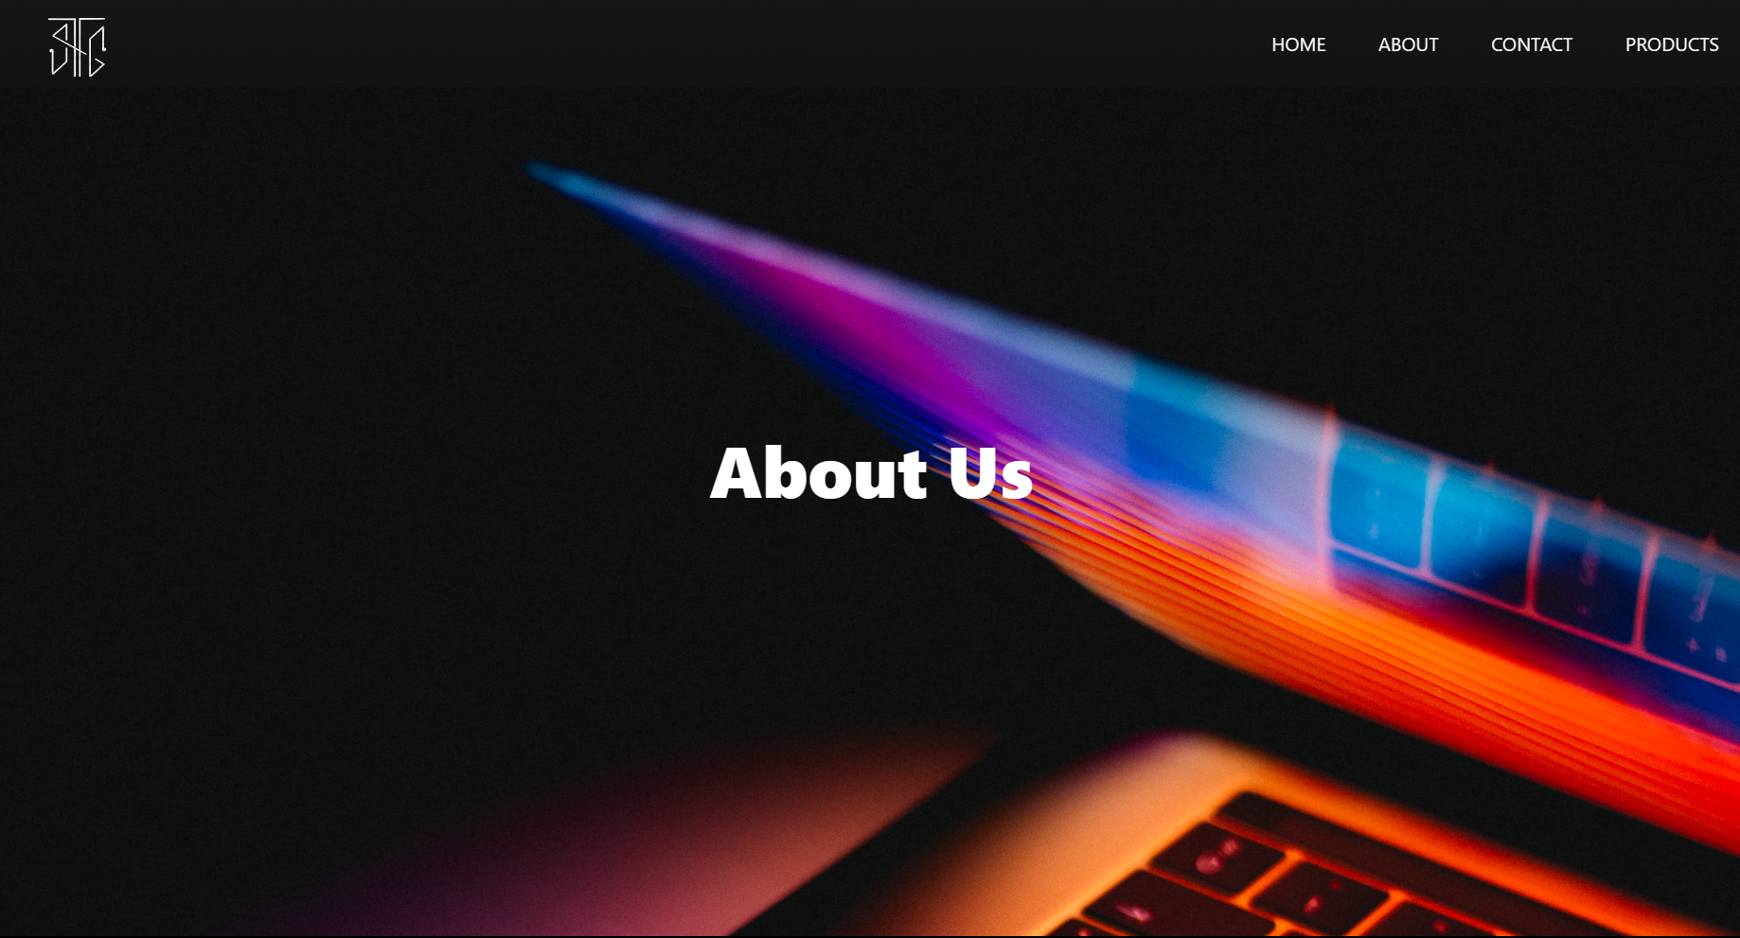
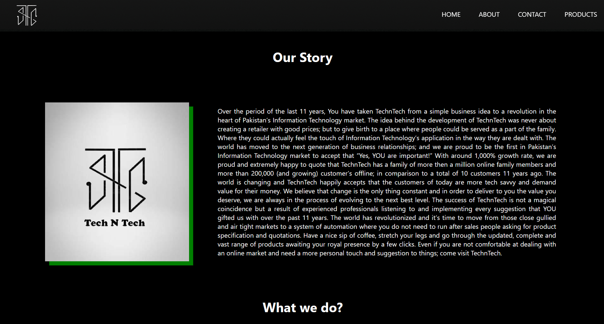
ABOUT PAGE
This page is divided into three sections:
Our Story: This will include some text about the company.
What we do?: This will include an introduction of our the website.
Our Partners: This will include the brands the company deals with.

Slide 8

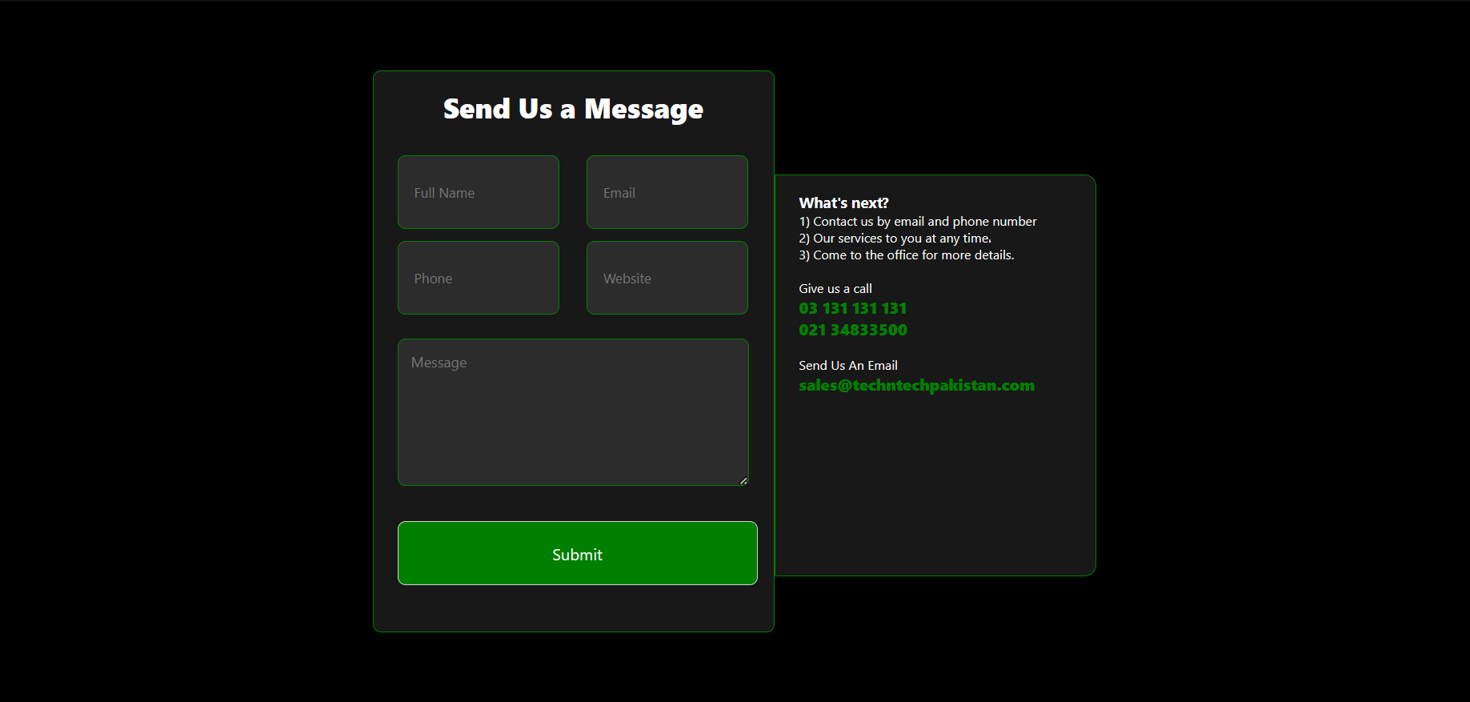
CONTACT PAGE
This page is divided into two sections:
Contact Form: This section includes a form by which users can contact us.
Location: This section includes our locations.

Slide 9
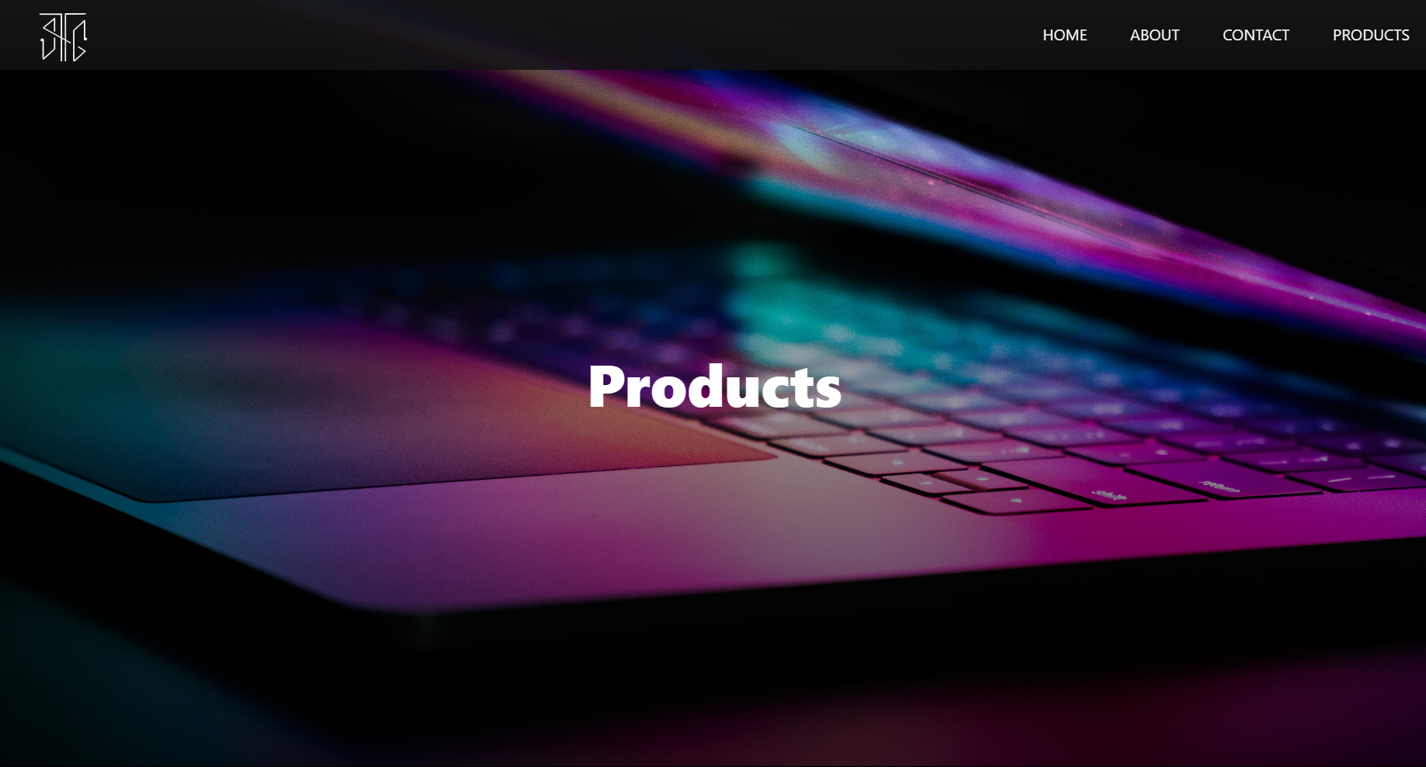
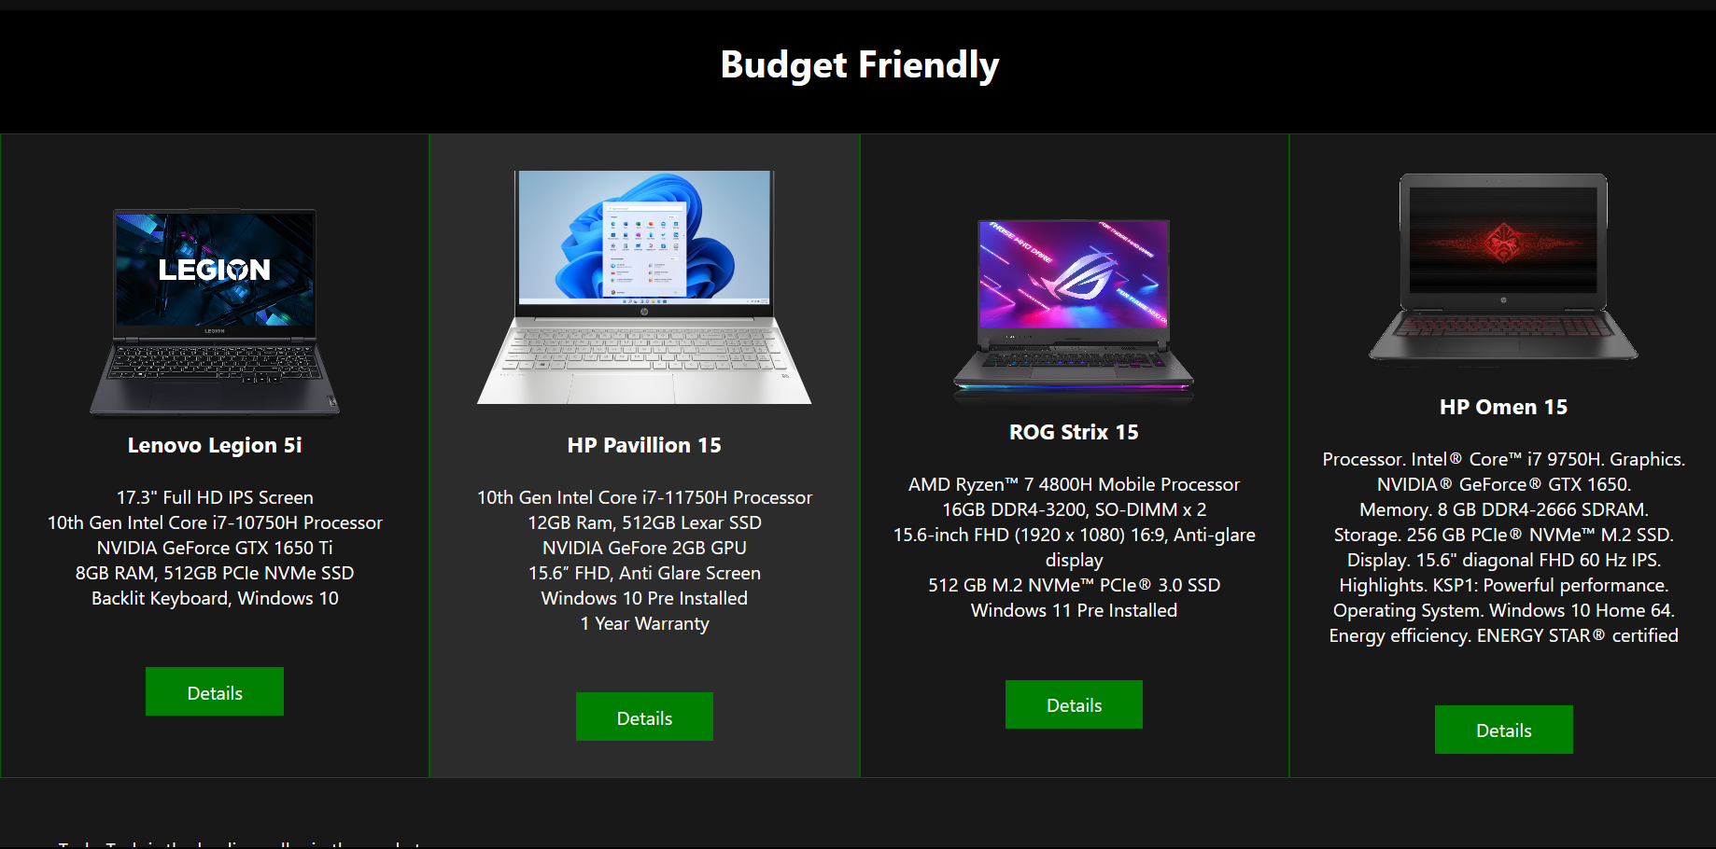
PRODUCT PAGE
This page is divided into three sections:
Most popular: This section includes the most popular laptops.
Newly arrived: This section includes laptops that are newly arrived.
Budget friendly: This includes laptops that are budget friendly.

Slide 10
HTML TAGS USED:
<iframe></iframe>
An inline frame (iframe) is a HTML element that loads another HTML page within the document. It essentially puts another webpage within the parent page. They are commonly used for advertisements, embedded videos, web analytics and interactive content.
<div></div>
The <div> tag defines a division or a section in an HTML document. The <div> tag is used as a container for HTML elements - which is then styled with CSS. It is easily styled by using the class or id attribute. Any sort of content can be put inside this tag.
<a></a>
Anchor tag creates a hyperlink on the page. By using this the website can be redirected to a specific link or to different pages.

Slide 11
CSS PROPERTIES USED:
Flexbox: Flexbox is usually referred to as flexible box, was designed as a one-dimensional layout model, and as a method that could offer space distribution between items in an interface and powerful alignment capabilities.
:hover: It is a pseudo class which is used to create different effects on the hover of a mouse on a certain div or an element.
:nth-child: It is also a pseudo selector to select a specific child of a parent element.
Transition: It is used to create an animation effect.
Transform: CSS Transform property transforms the object according to the attribute given to it.

Slide 12
Summary
In summary, this website is a platform that allows users to easily browse and purchase laptops online. It has a clean and user-friendly design, making it easy for users to navigate and find the information they need. It features a homepage, product page, about page, and contact page that provide a seamless and efficient shopping experience for the users. This website is ready to be deployed for the business to use, and can be expected to improve the customer's shopping experience and increase sales.

Slide 13
THANK YOU
qureshik488@gmail.com
zonissshahmed@gmail.com
bilalmasroorahmed909@gmail.com

